Slide 1

Quiz-A-Roo
AI-Powered Adaptive Quiz Platform
Group Members: [Name 1, Name 2, Name 3, etc.]

Slide 2
Table of Contents
What is Quiz-A-Roo?
The Problem with Traditional Quiz Apps
Key Objectives
Core Features
AI Component: LLM Integration
Technology Stack
System Workflow
User Interface: Quiz Screen
Leaderboard & Competition
Player Profile & History
Key Innovations
Conclusion
Thank You

Slide 3


What is Quiz-A-Roo?
Quiz-A-Roo is a smart quiz platform that combines AI-generated content, reliable fallback questions, and game-like competition to keep learning engaging.
AI-Generated Questions
Always Available
Creates fresh multiple-choice questions in real time using Large Language Models for any topic and difficulty.
Backup system with pre-made questions ensures the app works even when the AI service is unavailable.
Game Mechanics
Secure Login
XP points, star ratings, unlockable stages, and a public leaderboard for competitive engagement.
Secret Explorer ID system (e.g., ROO-123456) — no passwords required.

Slide 4



The Problem with Traditional Quiz Apps
🔁 Repetitive Content
📉 Limited Scale
Fixed question lists written by hand become stale and predictable quickly.
Hand-authored content cannot keep pace with the demand for fresh, varied material.
🚫 No Personalization
✅ Quiz-A-Roo's Answer
No adaptation to individual difficulty preferences or topic interests.
AI-generated, unlimited content tailored to any topic and any difficulty level.

Slide 5

Key Objectives
1
AI Question Generation
Use LLMs to create quiz questions for any topic and difficulty with well-crafted prompts.
2
Resilient Architecture
Fallback AI models and an offline question bank ensure continuous availability.
3
Fair & Secure Play
Answer shuffling prevents bias; Secret Explorer ID delivers password-free security.
4
Gamification & Competition
Stage-based progression with XP, star scoring, and a public leaderboard.

Slide 6


Core Features
Six capabilities that power a seamless, secure, and engaging quiz experience.
AI Quiz Generation
Fresh questions for any topic and difficulty level, generated on demand.
Safe Login
Secret Explorer ID system — no passwords, no friction.
XP & Star Scoring
0–3 star ratings per quiz with XP-based progression across seven unlockable stages.
Public Leaderboard
Top players ranked by XP, motivating repeat engagement and healthy competition.
Answer Shuffling
Server-side randomization prevents correct-answer placement bias.
Quiz History
Complete record of all quizzes taken for tracking personal progress.

Slide 7
UML
Use case diagram
Quiz-A-Roo system
Register / Login
Choose topic
Choose difficulty
Play quiz
View results
Review history
Explorer
AI provider / fallback bank
View leaderboard
External services

Slide 8



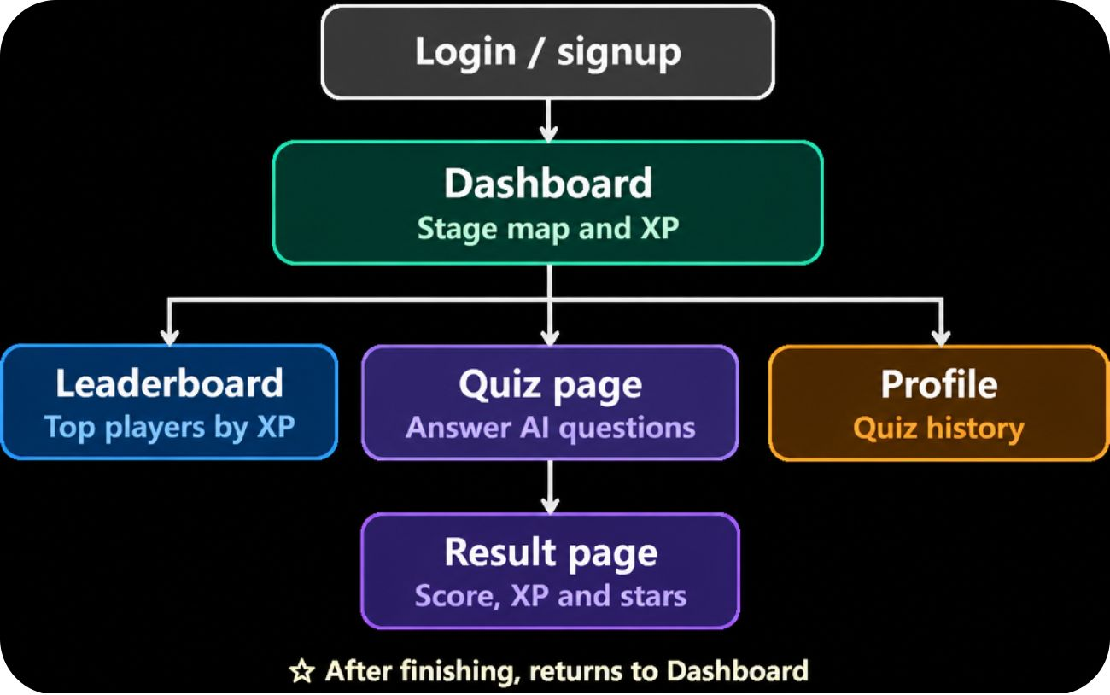


AI Component: LLM Integration
Multiple AI Providers
Clean JSON Format
Supports multiple AI services with automatic selection and seamless switching.
AI responses structured as JSON for reliable parsing and clean data flow.
Timeout Protection
Always Available
16-second limit prevents the app from hanging on slow AI responses.
Seamless fallback to backup questions if all AI models fail — zero downtime.

Slide 9





Technology Stack
Frontend
Database
React.js + Stitch-inspired UI
Supabase
Backend
Deployment
Express.js & Node.js
Vercel
Dev Tools
GitHub, VS Code, Jira

Slide 10

System Workflow
Login/Register
Select Topic
Select Difficulty/Quiz Type
Generate Quiz
Check AI Key
Custom Quizzes
AI Creates Questions
A resilient pipeline gives every Explorer a fair, personalized quiz experience, with or without live AI access.

Slide 11
UML + WORKFLOW
Activity diagram: quiz workflow
Open app
Register / login
Select topic
Select difficulty
Generate quiz
yes
AI
ready?
no
Render questions
Use fallback bank
Answer loop → score → results → save

Slide 12
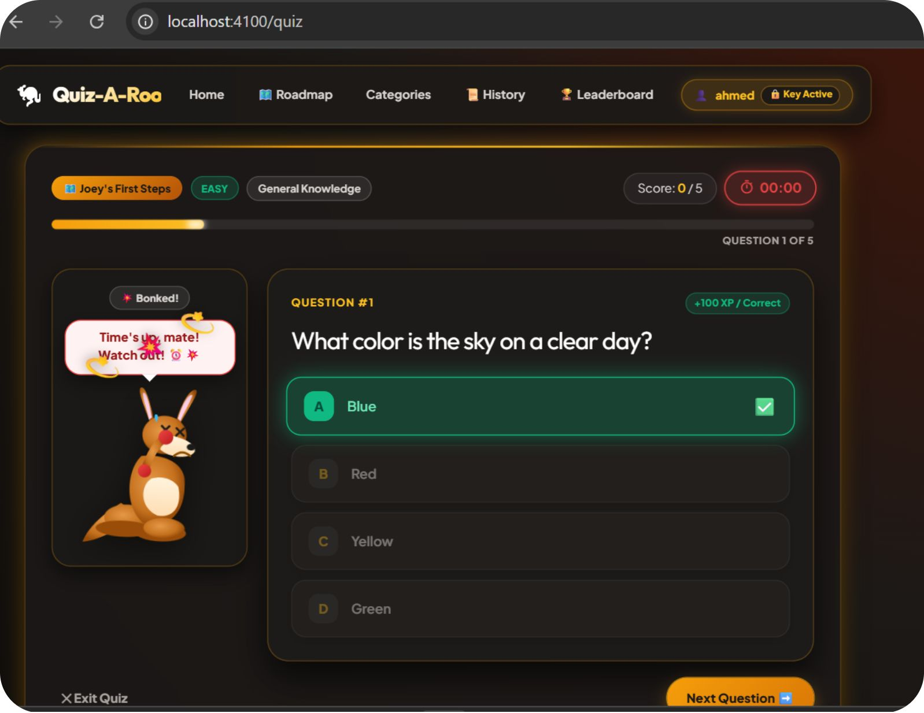

User Interface: Quiz Screen
Designed for Engagement
The Quiz-A-Roo interface keeps players focused and motivated throughout every session.
Clean, intuitive multiple-choice question layout
Live score tracker showing progress (e.g., 0/5)
Countdown timer adding urgency to each question
Friendly kangaroo mascot for encouragement and brand identity
Visual feedback on answer selection for instant clarity
Every UI decision prioritizes simplicity, speed, and player delight.

Slide 13
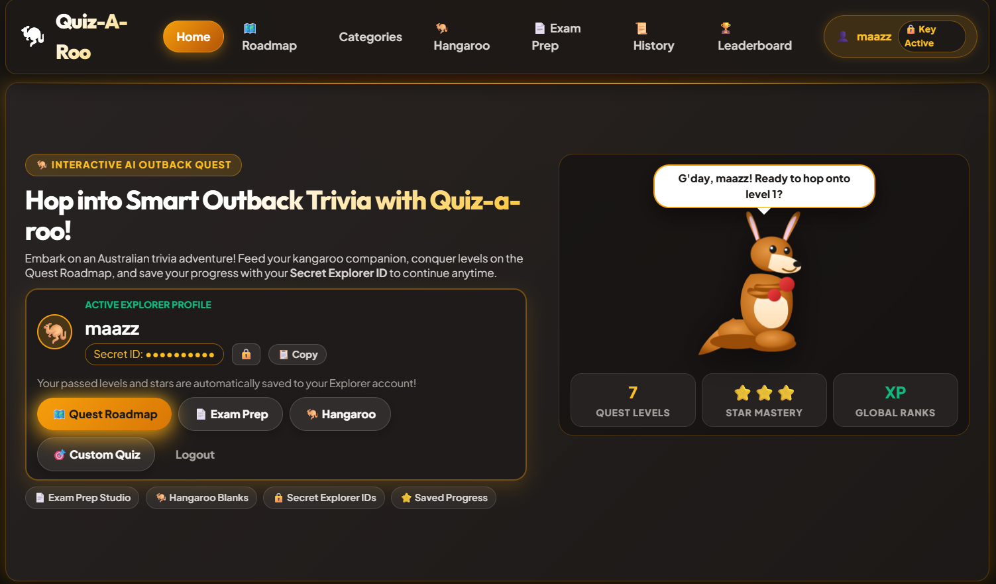
User Interface: Quiz Screen

Slide 14
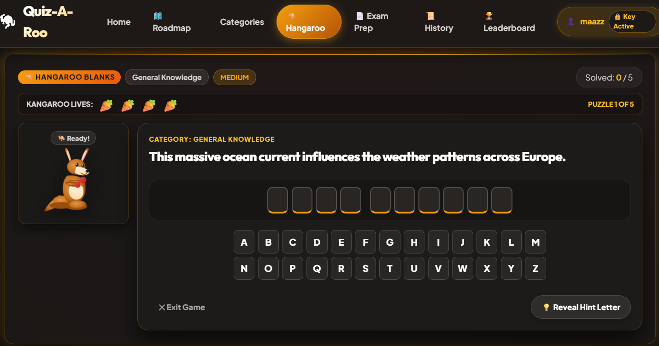
User Interface: Quiz Screen

Slide 15
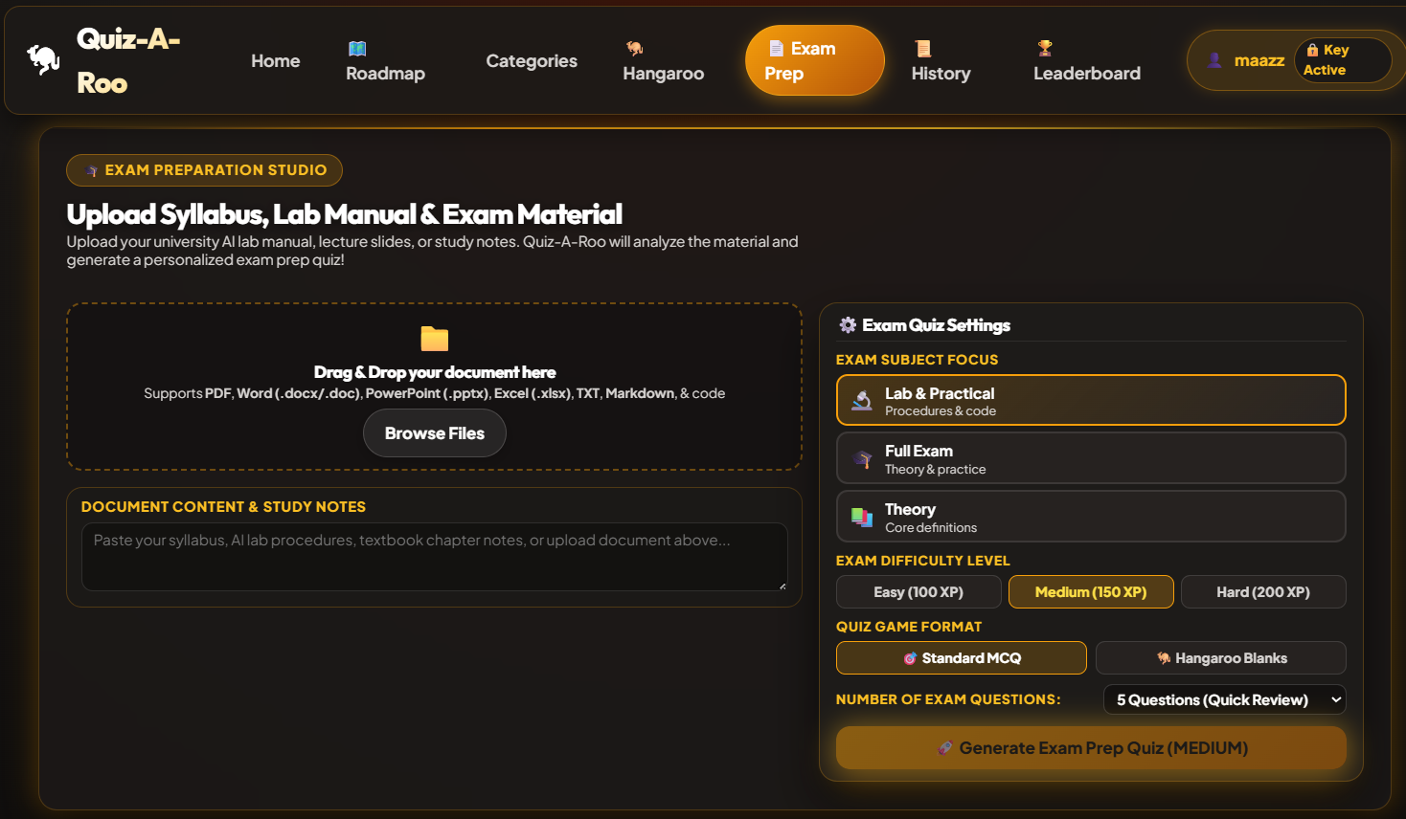
User Interface: Quiz Screen

Slide 16
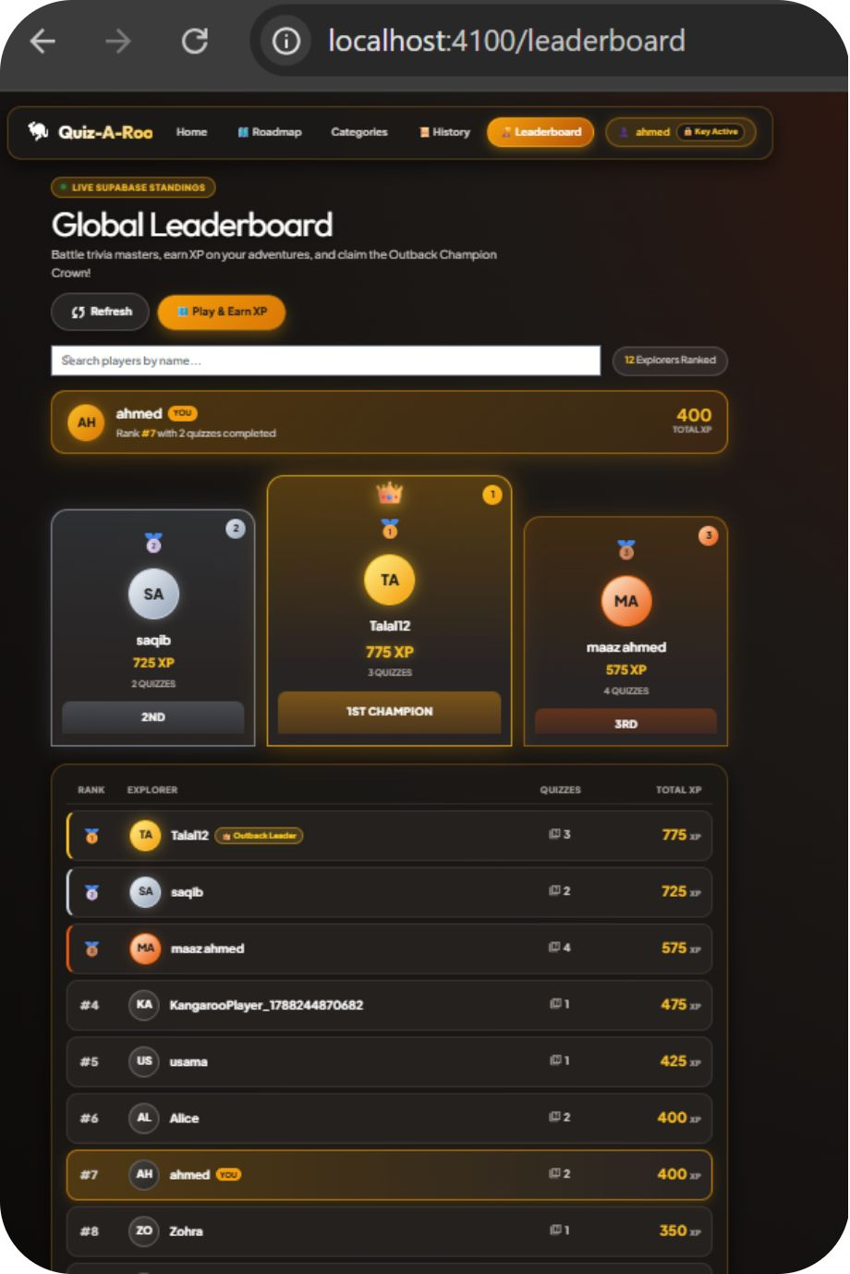

Leaderboard & Competition
Climb the Rankings
The global leaderboard displays top players ranked by XP — turning individual progress into a shared competitive experience.
Global rankings visible to all players
Privacy preserved with password-free Secret Explorer IDs
Drives repeated engagement and continuous skill development
Motivates players to master new topics and push through harder stages
COMPETE. IMPROVE. RISE.

Slide 17






Conclusion: Quiz-A-Roo
AI-Powered Adaptive Quiz Platform
Practical LLM Integration
A novel approach to interactive learning, designed for engagement and effectiveness.
Demonstrates effective use of Large Language Models for dynamic content generation.
Cutting-Edge Tech & Game Mechanics
Unlimited Personalized Learning
Seamlessly blends advanced technology with engaging gamification for a superior user experience.
Offers endless, tailored quiz content to match any topic and difficulty level.
Modern AI App Development Showcase
Innovation with Reliability
Highlights essential skills and best practices for building robust AI-driven applications.
Intelligent fallback systems ensure continuous availability and a consistently smooth experience.

Slide 18
Thank You!
We appreciate your time and interest in Quiz-A-Roo and our vision for the future of adaptive learning.

